Slide 1
Bootcamp
Python for Data Science

Slide 2
Using APIS

Slide 3

API
Application Programming Interface
website for programs — no visuals

Slide 4
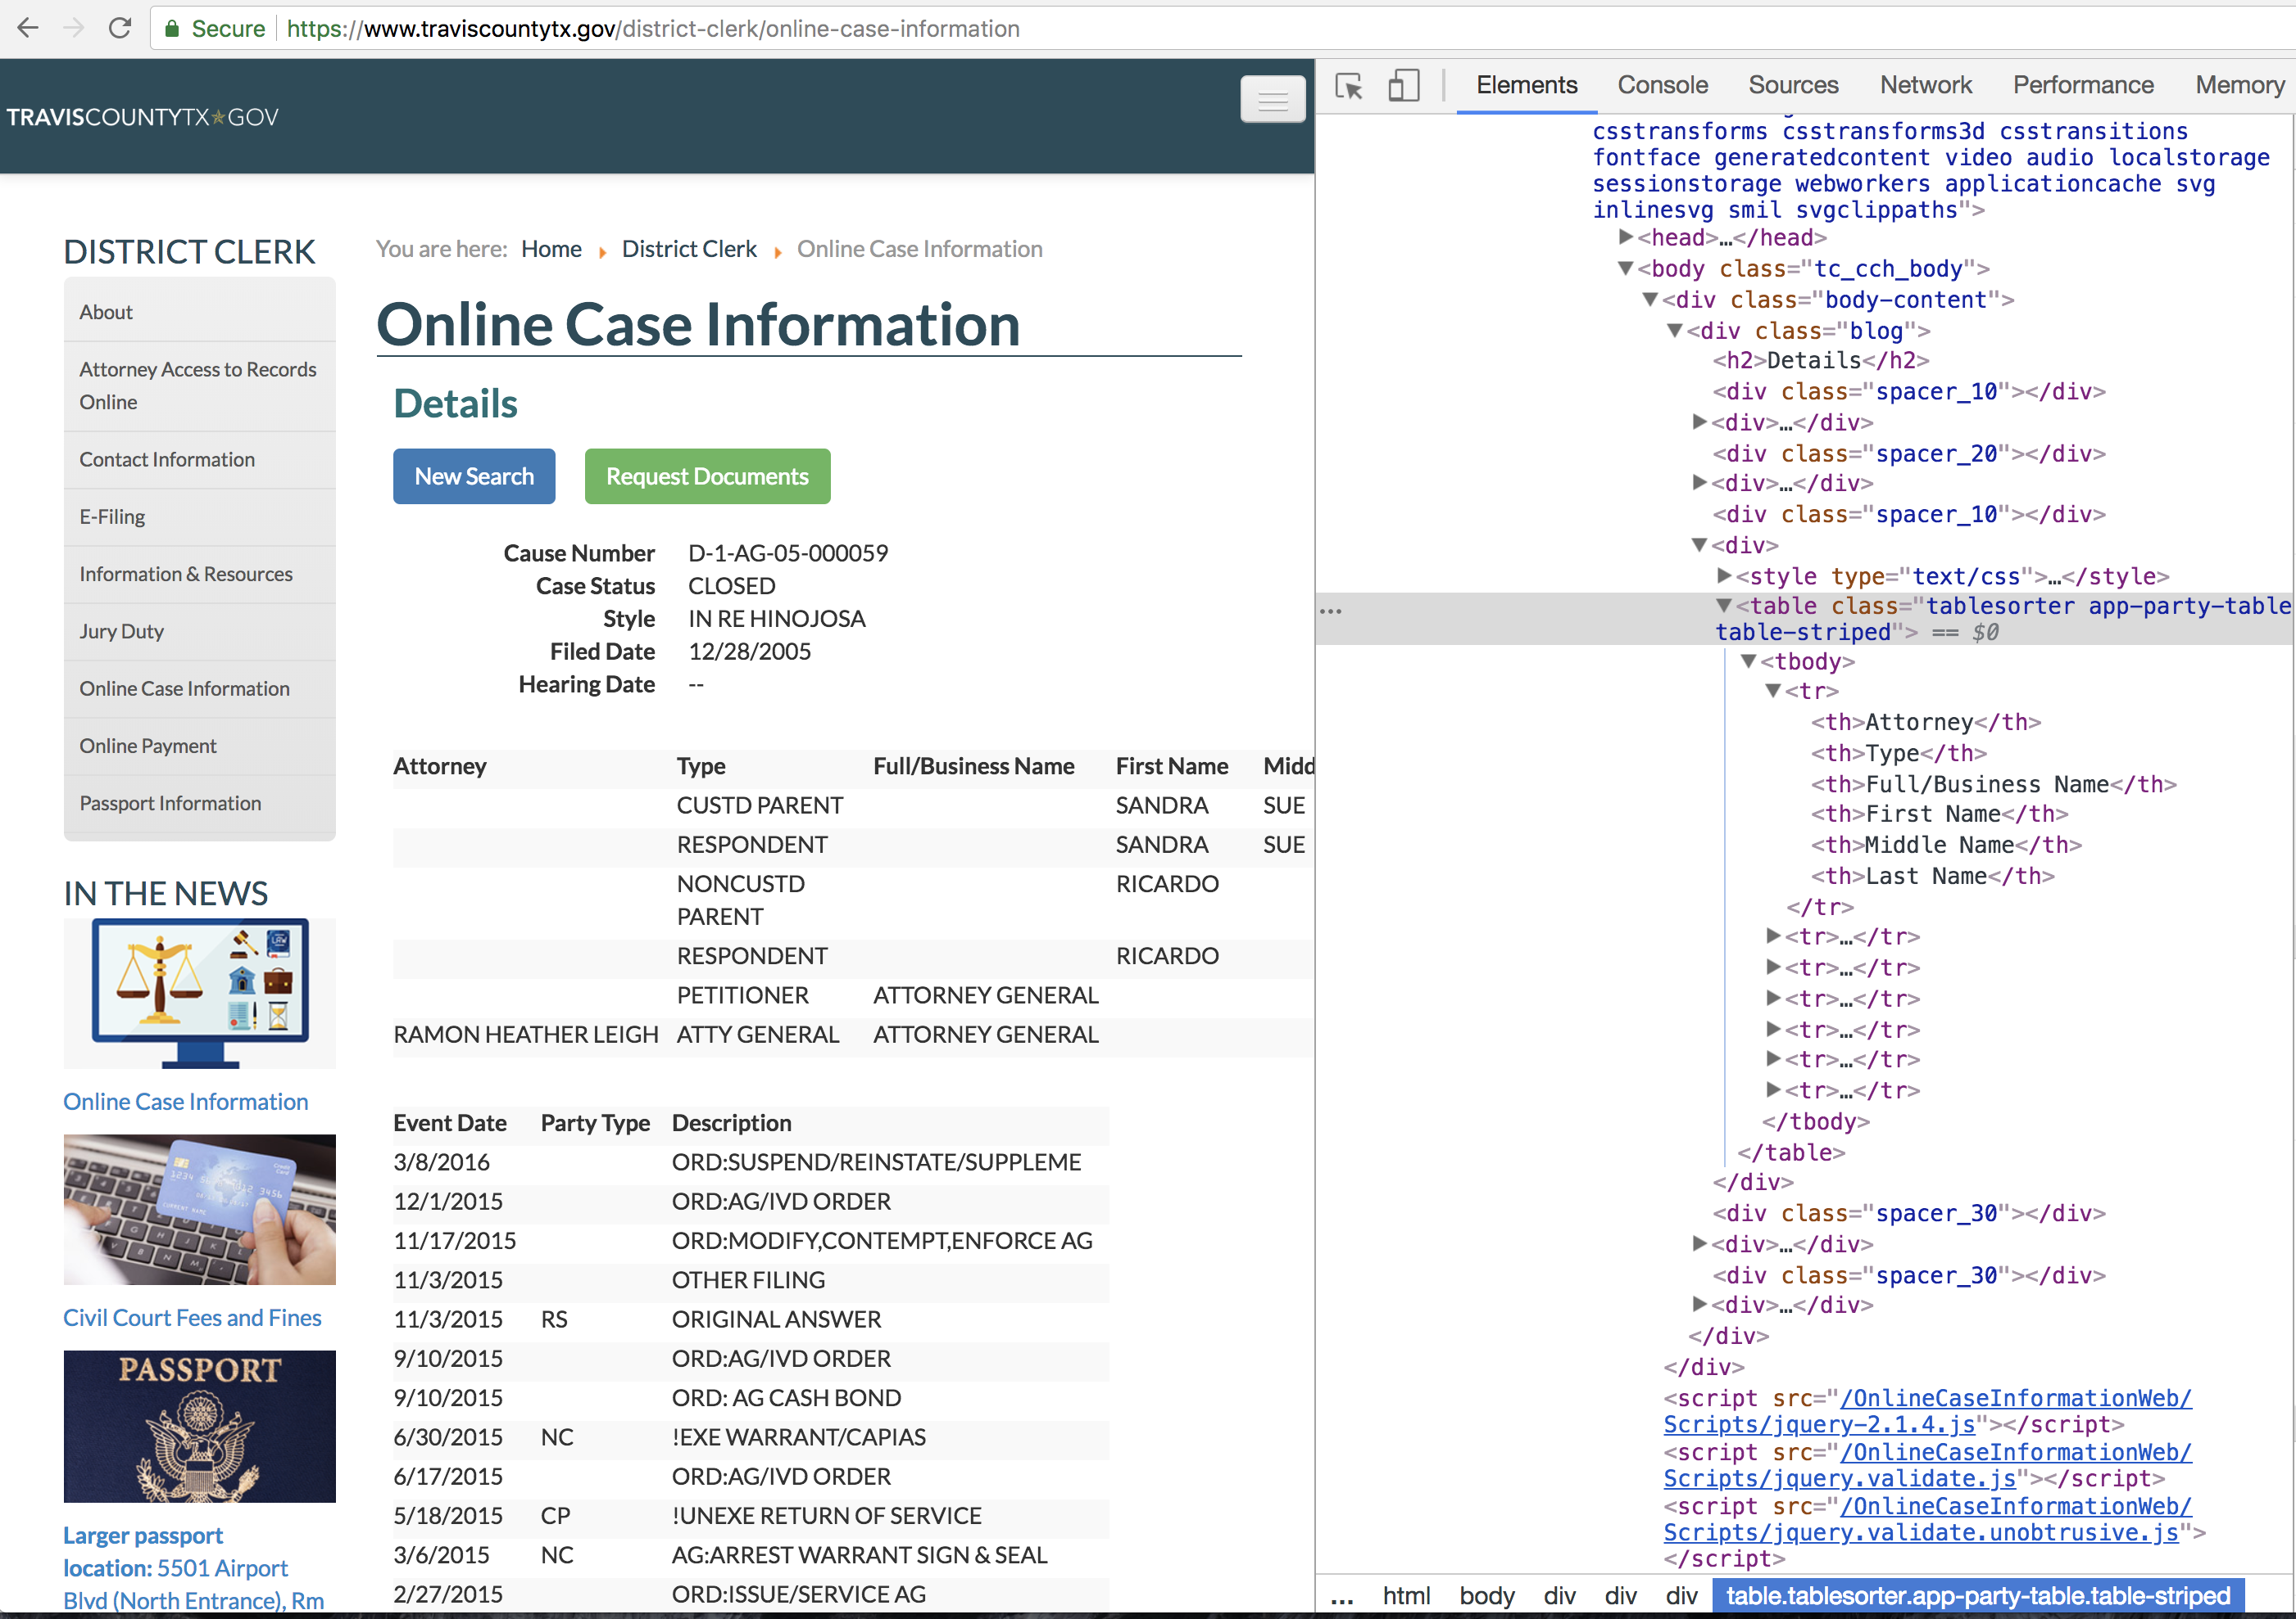

Slide 5

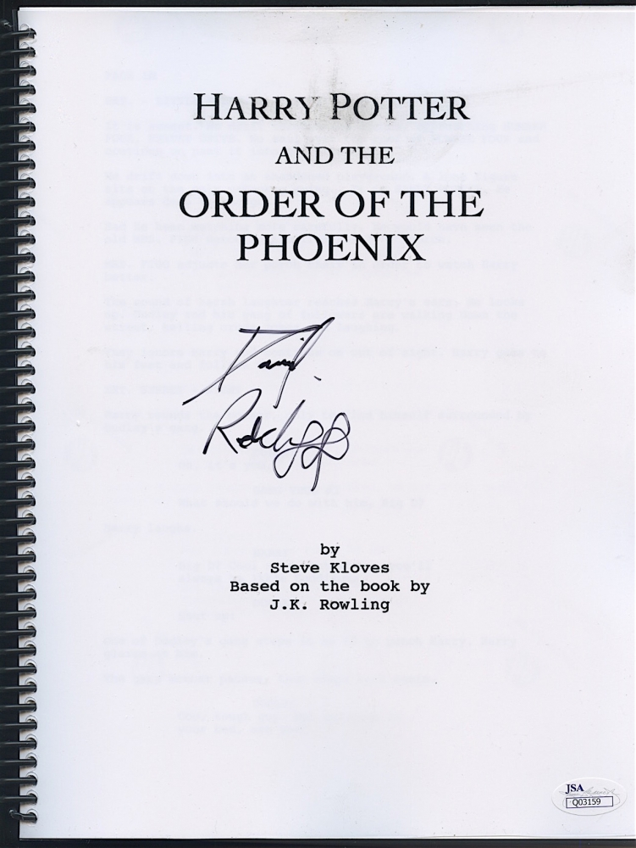
HTML

Slide 6
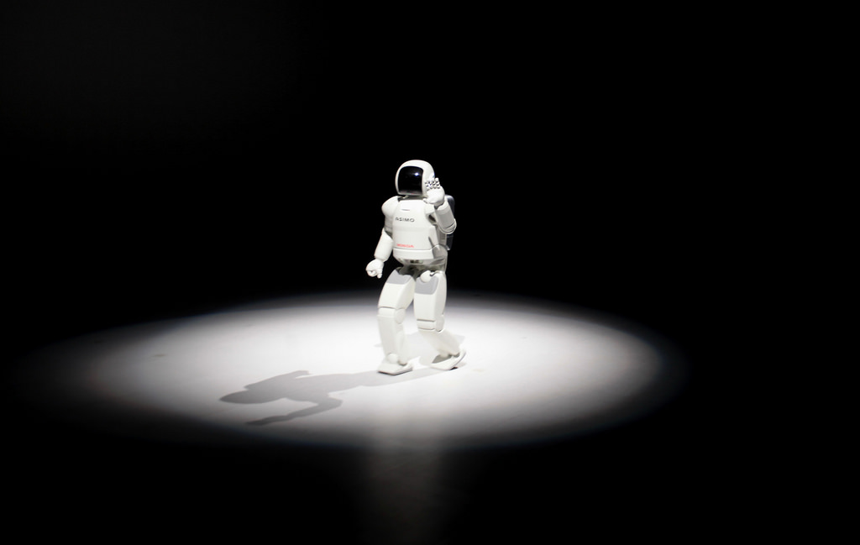
No thanks

Slide 7
Json (Javascript object notation)
Simple format for sending data
Turns into a Python dictionary!

Slide 8
Json
{
"name": “John Smith",
"address": {
"street": "21 2nd Street",
"city": "New York” }
}

Slide 9
API
Going to use IEXTrading.com
No account/password needed!

Slide 10
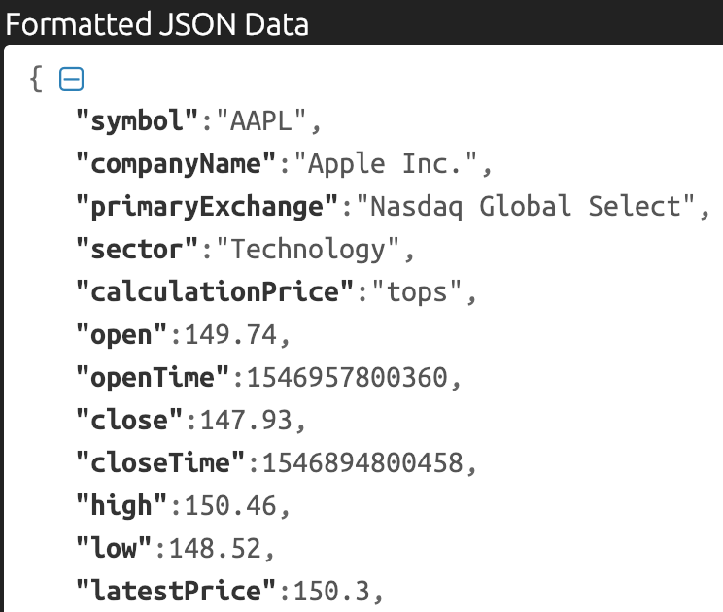

Slide 11
HTTP (Hypertext Transfer Protocol)
Each request has a verb like GET or POST
Data returned in body of response

Slide 12
Requests Package
Most popular Python package
Makes HTTP requests simple

Slide 13
Using Requests
import requests
url = “https://api.kanye.rest/"
response = requests.get(url)
response.text

Slide 14
Using Requests
import requests
url = “https://api.kanye.rest/"
response = requests.get(url)
response.text
body of response

Slide 15
Using Requests
data = response.json()

Slide 16
Using Requests
data = response.json()
{“date":"2019-03-05",
“high":176,
"low":174.54,
"volume":19737419}

Slide 17
Concepts covered so Far
API
JSON
Requests
HTTP/HTTPS

Slide 18
Exercises

Slide 19
Dataframe from dicts
pd.DataFrame.from_dict(dict_list)

Slide 20
Dataframe from dicts
pd.DataFrame.from_dict(dict_list)
Dicts must all have same keys!

Slide 21
Combining Data

Slide 22
Row-Wise
append
concat

Slide 23
Append
df1.append(df2)

Slide 24
Column-wise
merge

Slide 25
Merging Data
pd.merge(df1,df2)

Slide 26
Merging Data
pd.merge(df1,df2,on=“shared column”)

Slide 27
Merging Data
pd.merge(df1,df2,
left_on=“columnName”
right_on=“columnName”)

Slide 28
Concepts covered so Far
Creating dataframes from dictionaries
Append
Concat
Merge

Slide 29
Exercises

Slide 30
Scripting

Slide 31
script
Code used as small program
No human needed, not interactive

Slide 32
Scripting use Cases
Automate routine tasks
Keep track of changing data

Slide 33
Jupyter to Script: Three steps
Extract code into a .py file
Figure out shell command to run
Schedule or run shell command

Slide 34

shell
What the heck is a

Slide 35
Useful Analogy
Website ————> HTML
Computer ————> SHELL

Slide 36
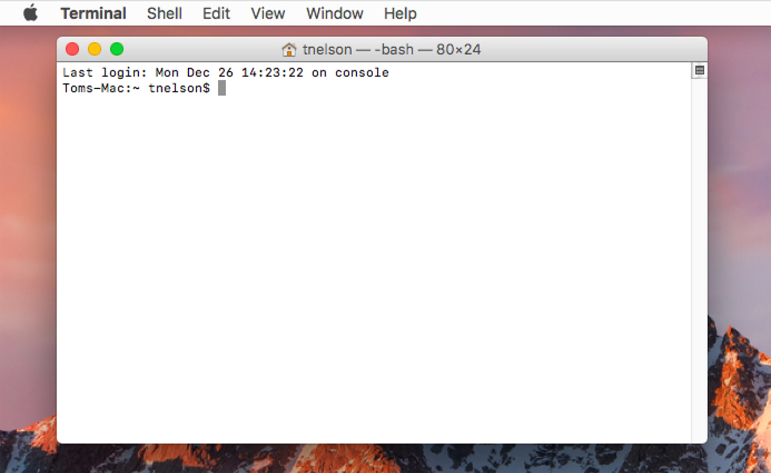
Text

Slide 37
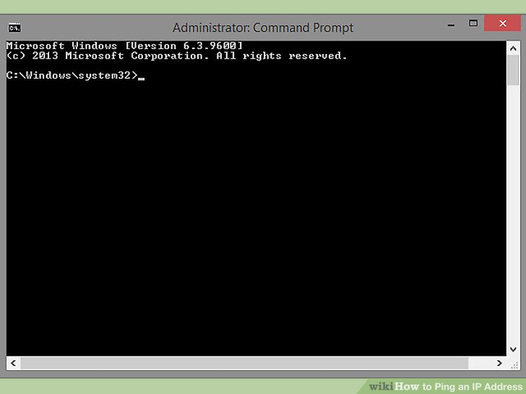
Text

Slide 38
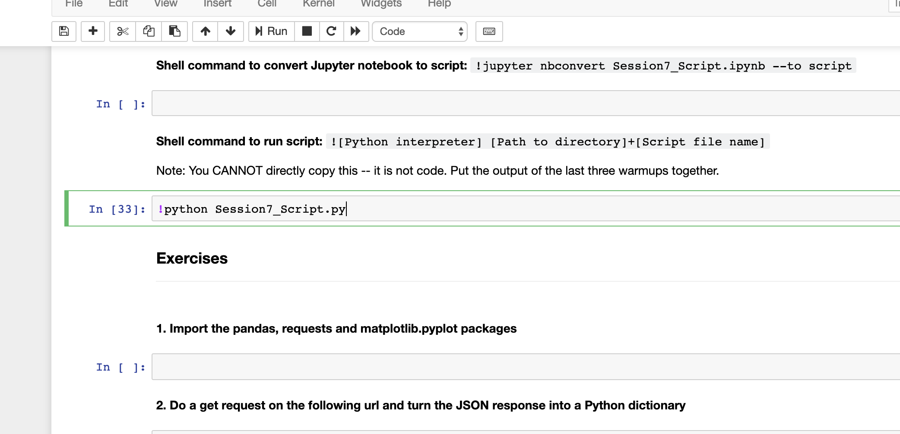
Text

Slide 39
Basic Shell Syntax
[program_name] [input] [--flags]

Slide 40
Shell command #1
“run this Python file”

Slide 41
Shell command #1
python my_script.py

Slide 42
Shell command #1
python my_script.py
C:\Anaconda3\python.exe

Slide 43
Shell command #1
python my_script.py
C:\Users\Rob\my_script.py

Slide 44
Shell command #2
“extract a .py file from this Jupyter notebook”

Slide 45
Shell command #2
jupyter nbconvert my_notebook.ipynb
--to script

Slide 46
Jupyter to Script: Three steps
Extract code into a .py file
Figure out shell command to run
Schedule or run shell command

Slide 47
Jupyter to Script: Three steps
Extract code into a .py file
Figure out shell command to run
Schedule or run shell command

Slide 48
Jupyter to Script: Three steps
Extract code into a .py file
Figure out shell command to run
Schedule or run shell command

Slide 49
Windows

Slide 50
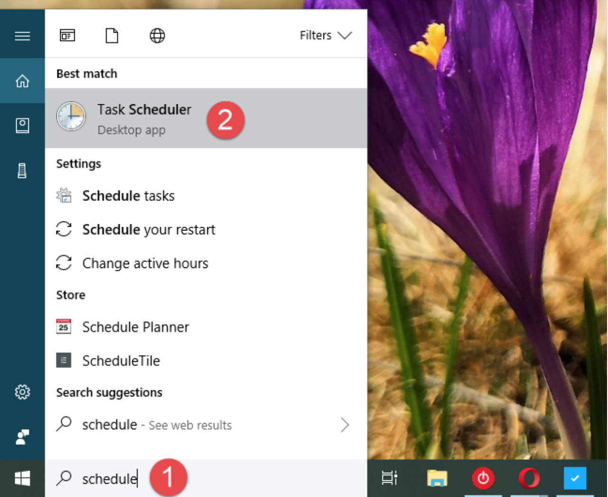
Text

Slide 51
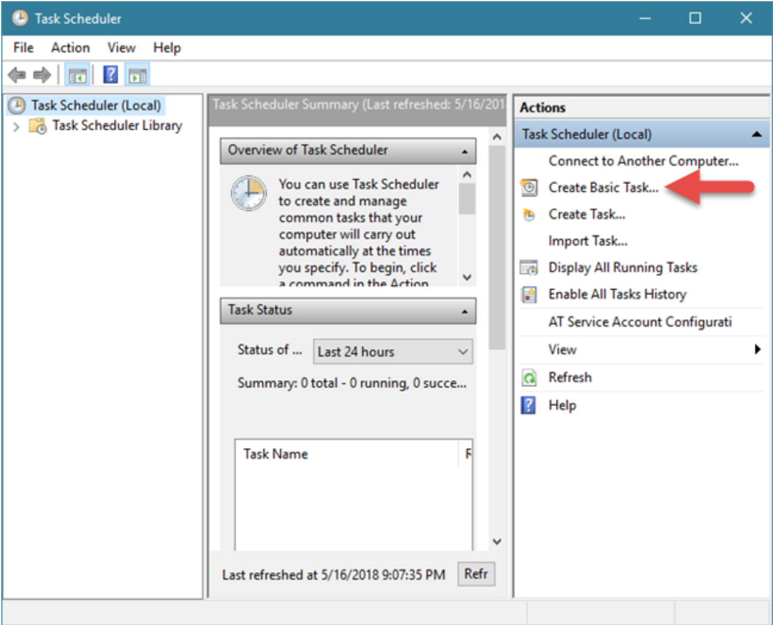
Text

Slide 52
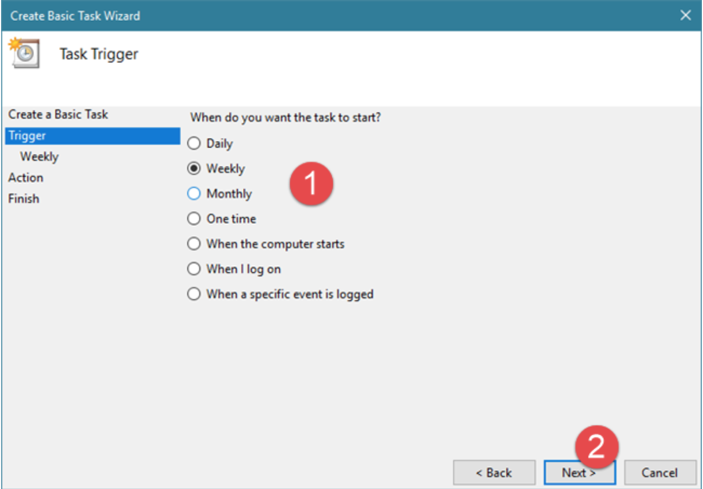
Text

Slide 53
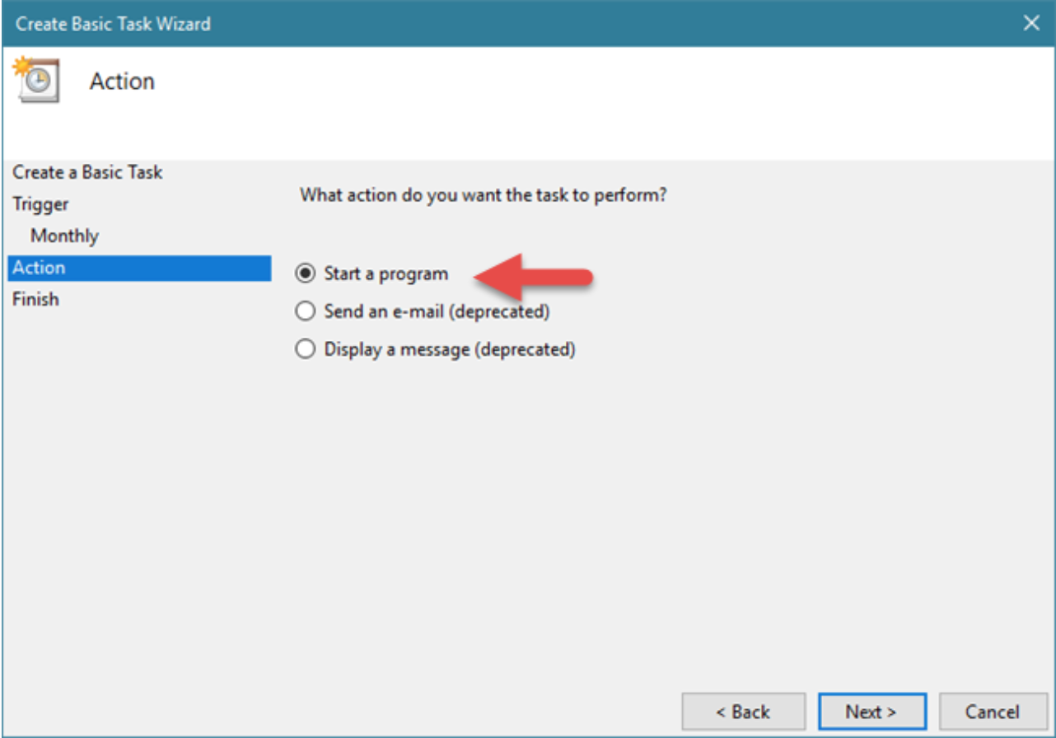
Text

Slide 54
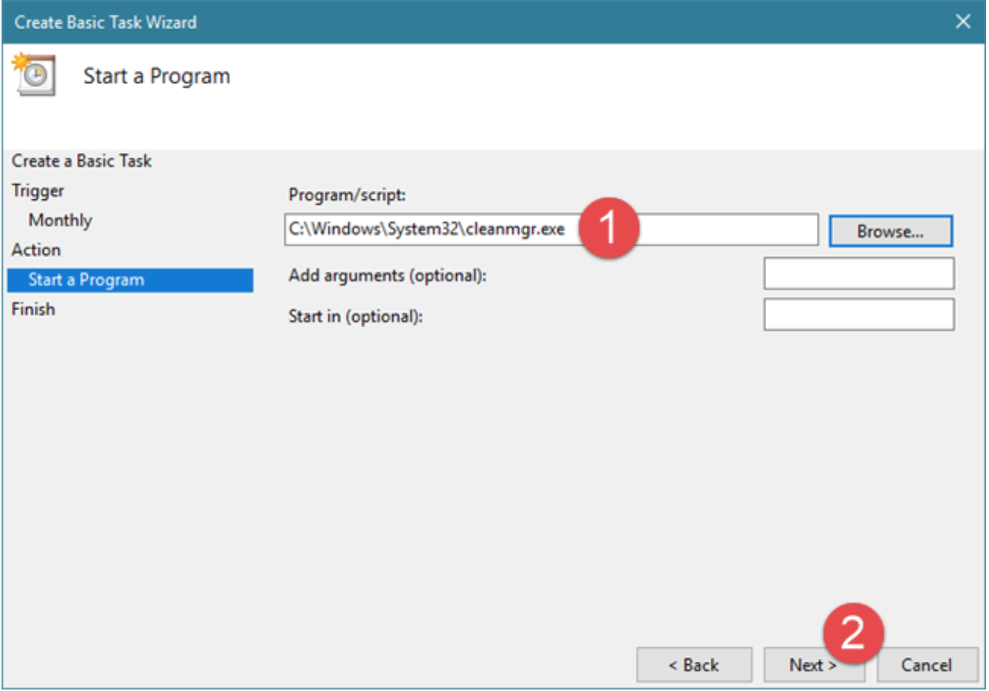
Text

Slide 55
Macintosh

Slide 56
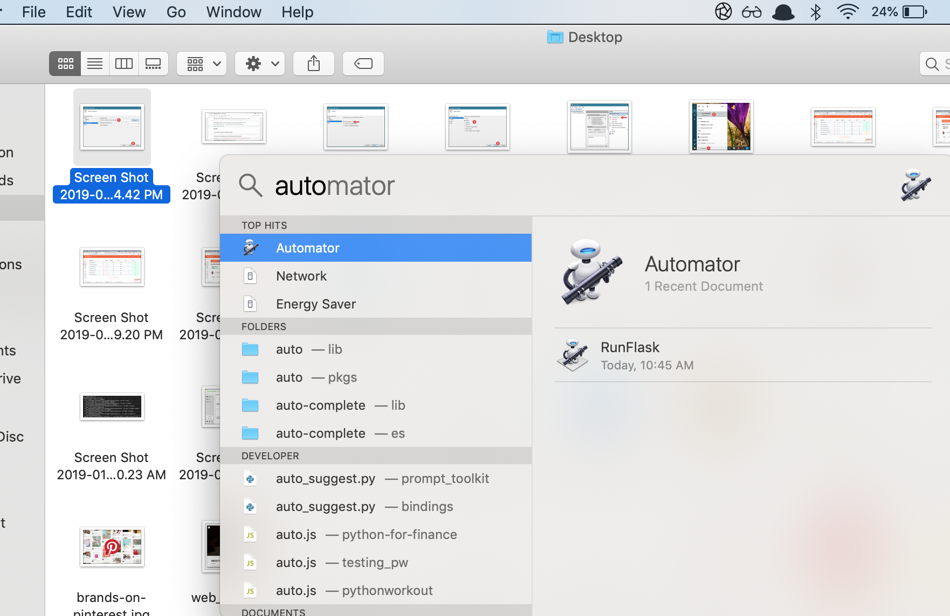
Text

Slide 57
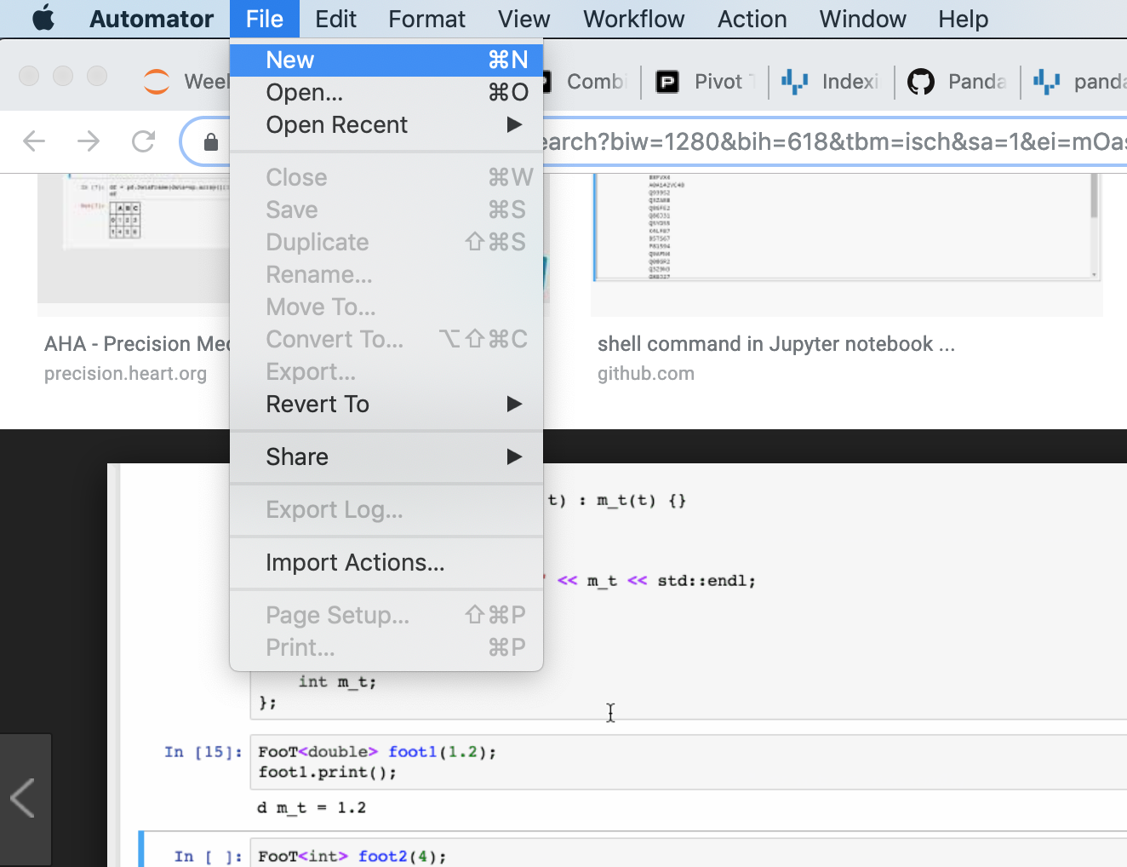
Text

Slide 58
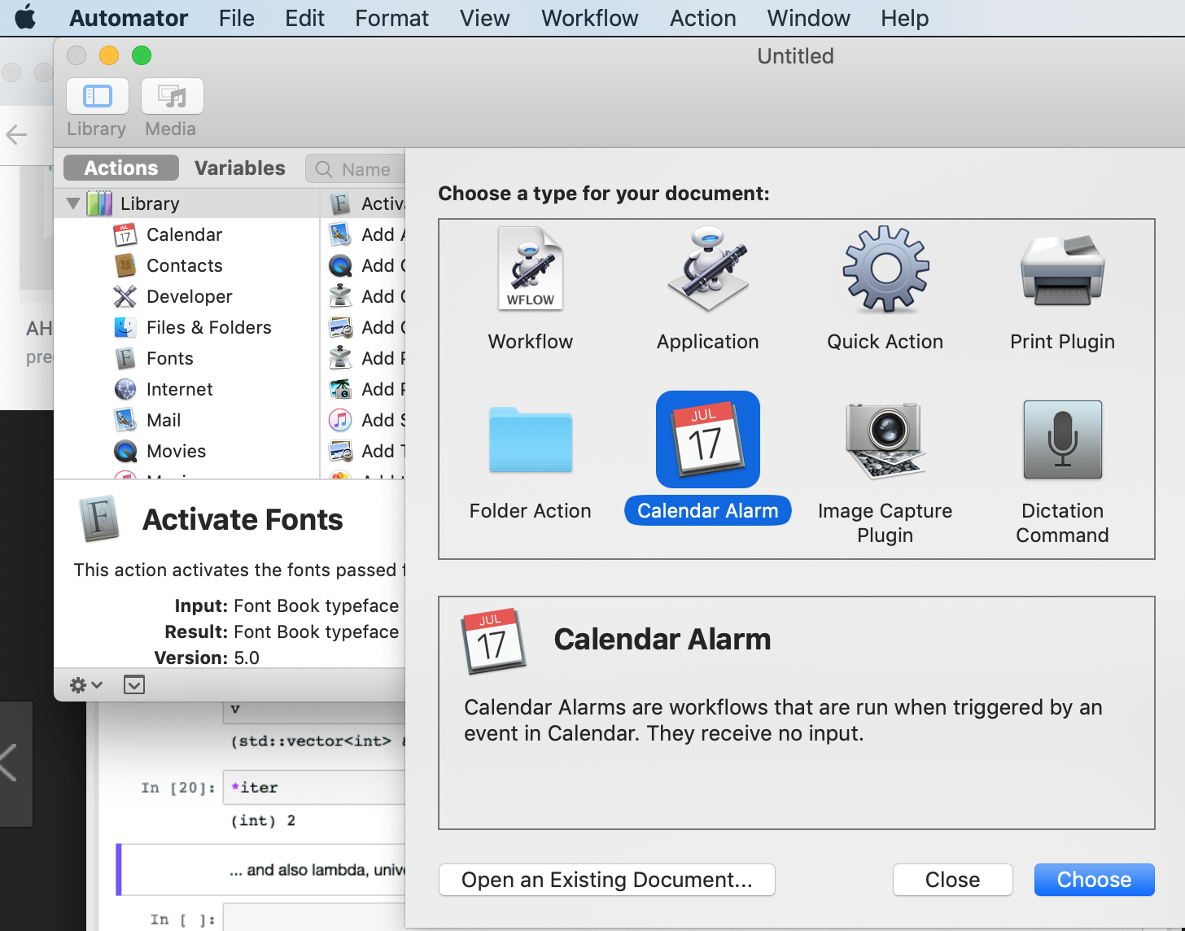
Text

Slide 59
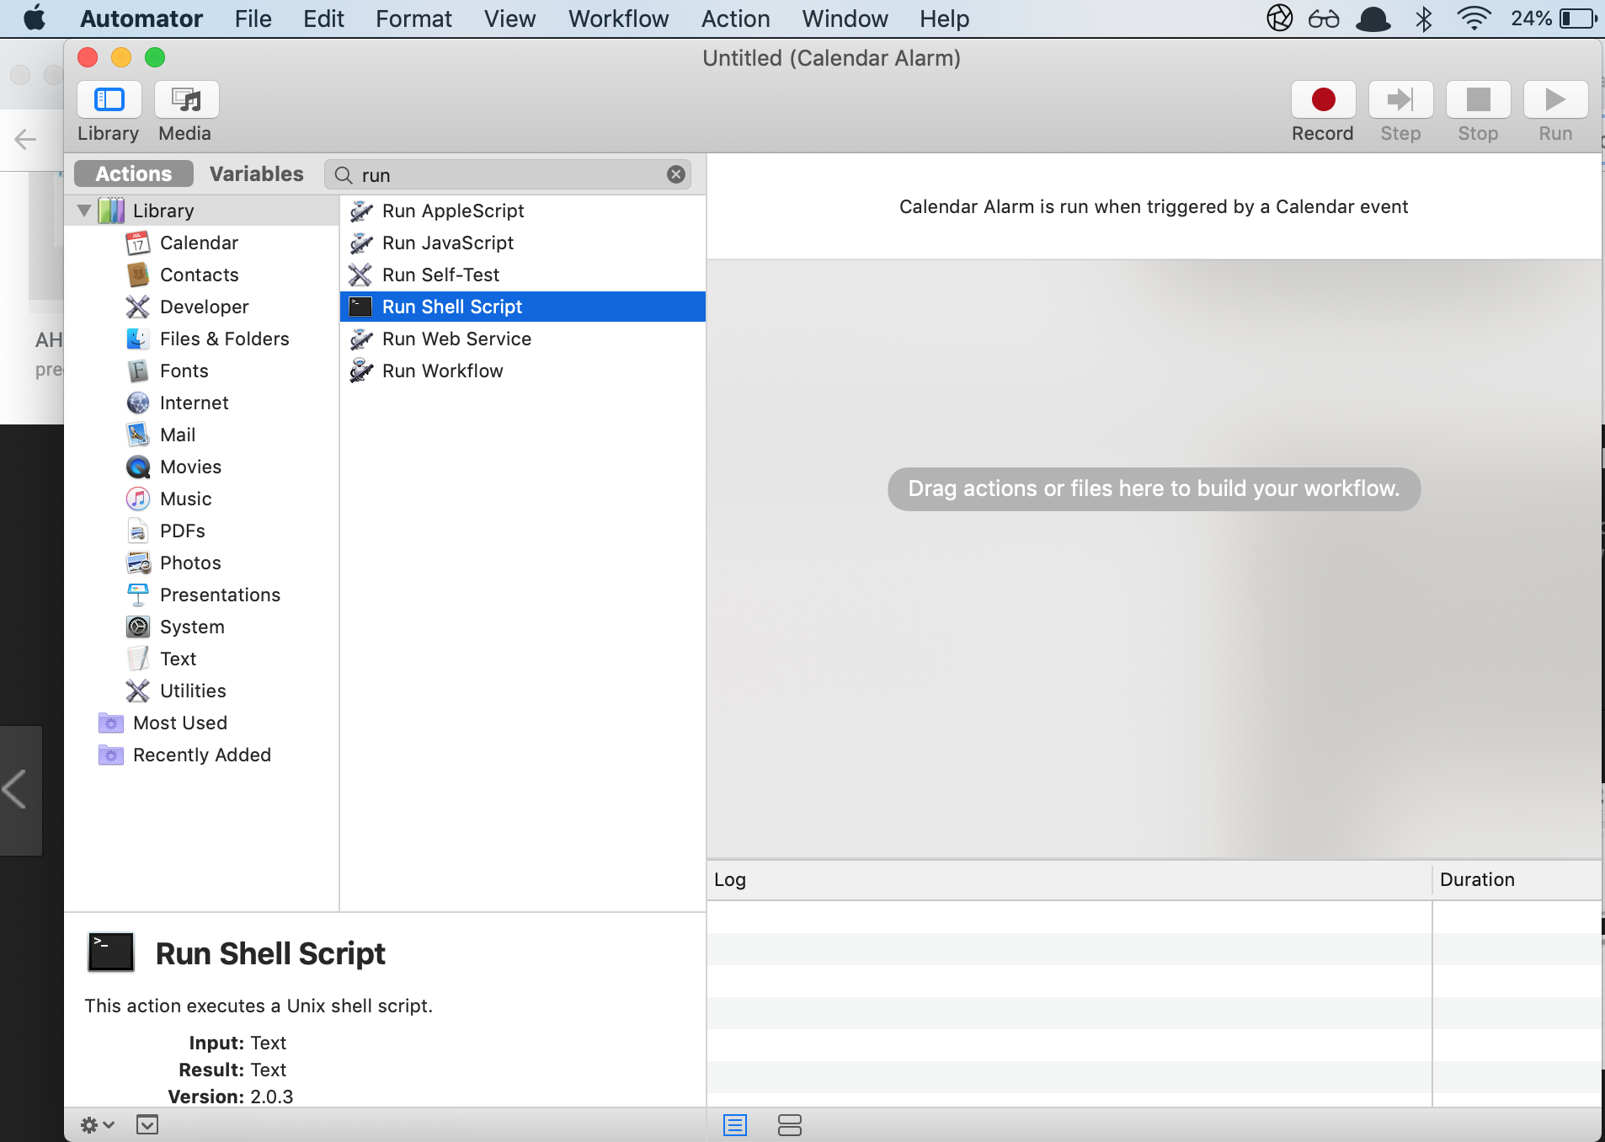
Text

Slide 60
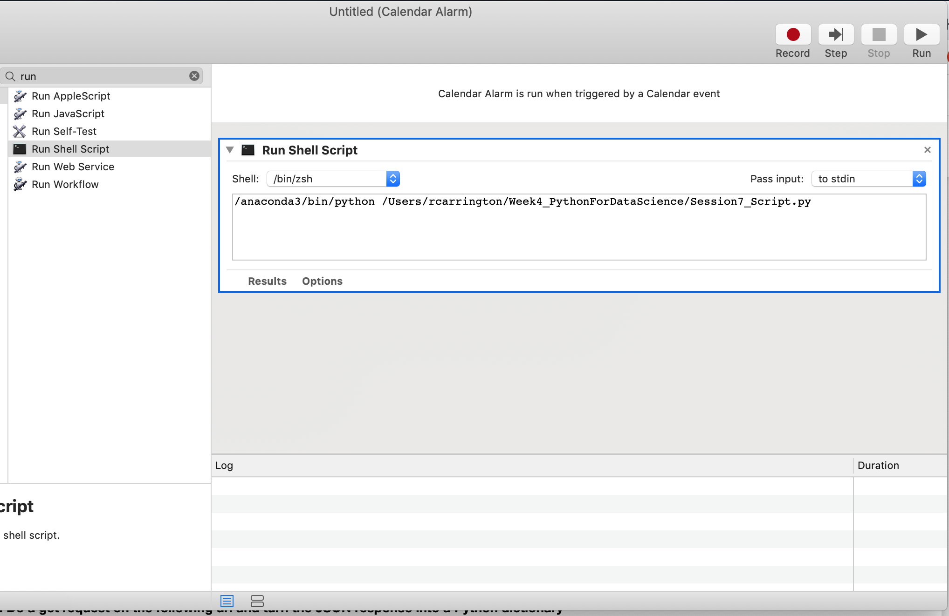
Text

Slide 61
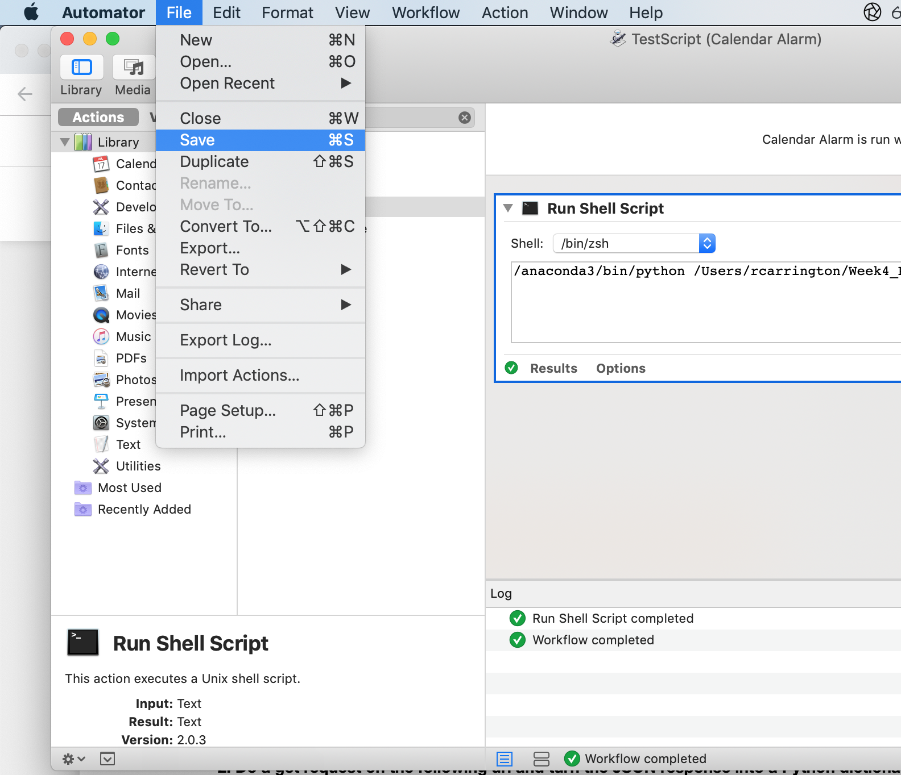
Text

Slide 62
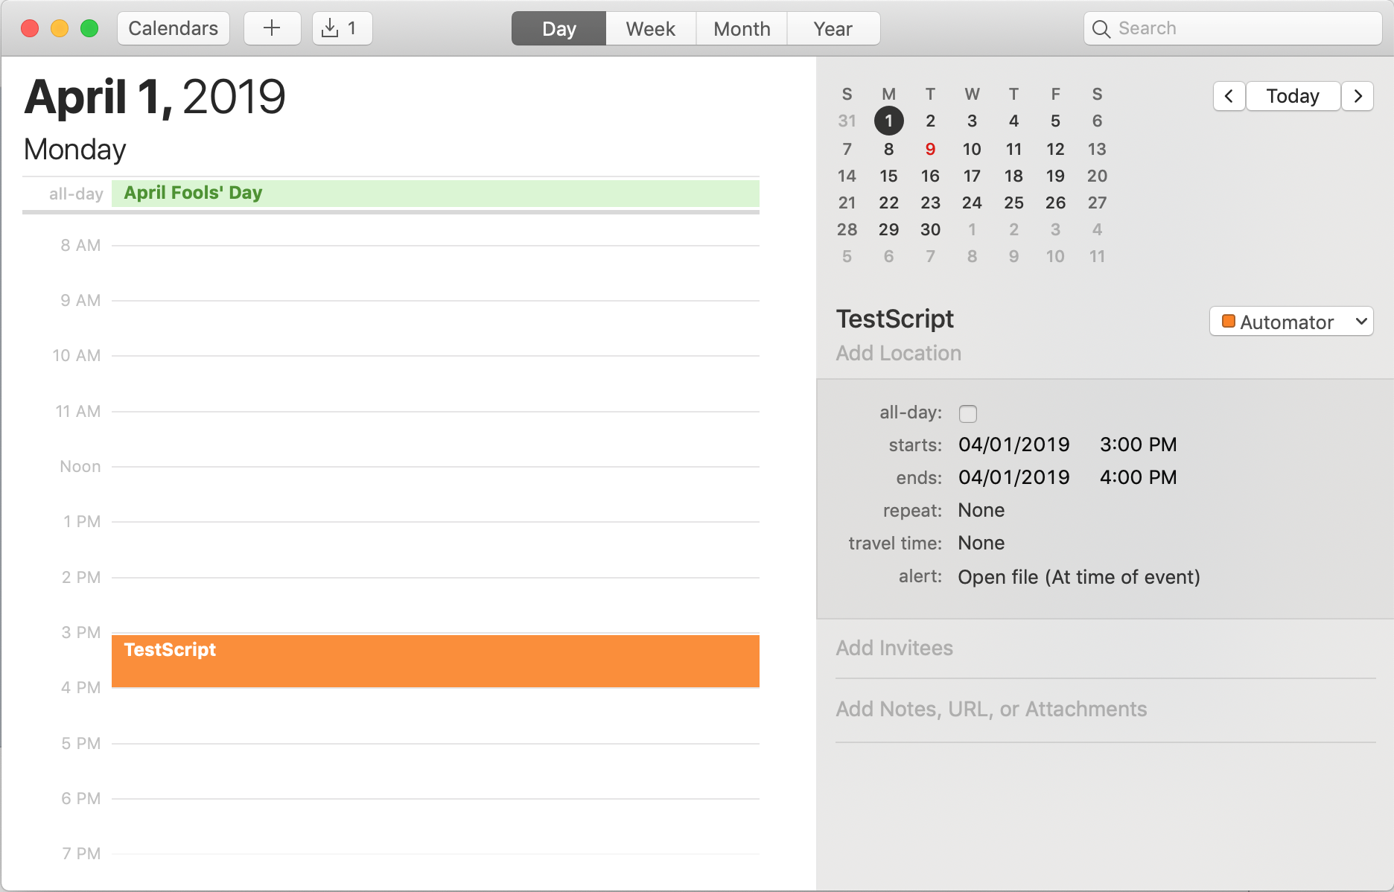
Text

